Slide 1
General Purpose Transfer Learning
Framework for Cross-Domain Classification
Supervisor:
Dr. Mohammad Shoyaib
Professor, IIT
Hasnain Sheikh
Roll: BSSE-1408

Slide 2
Project Motivation
Why Transfer Learning?
The Challenge
The Solution
This Project
Traditional ML models need large amount of labeled data specific to each domain; collecting label data is expensive, time-consuming, and often impractical. For new project, it is even more severe due to annotation scarcity, and the lack of sufficient labeled target-domain data.
Transfer learning addresses the issue by transferring knowledge from a source domain to a target domain, reducing dependence on domain-specific labeled data.
A unified framework for cross-domain transfer learning analysis, visualization, and evaluation across text, and image datasets; capable of improving performance in low-resource and cross-domain scenarios.

Slide 3
Project Objectives
What this framework aims to achieve
1
Build a unified pipeline for cross-domain learning experiments
2
Implement multiple transfer learning methods
3
Implement OCMTL+, a transfer learning method developed by me
4
Apply on text analysis (sentiment analysis), and image recognition
5
Provide an interactive dashboard system for experimentation and reporting

Slide 4
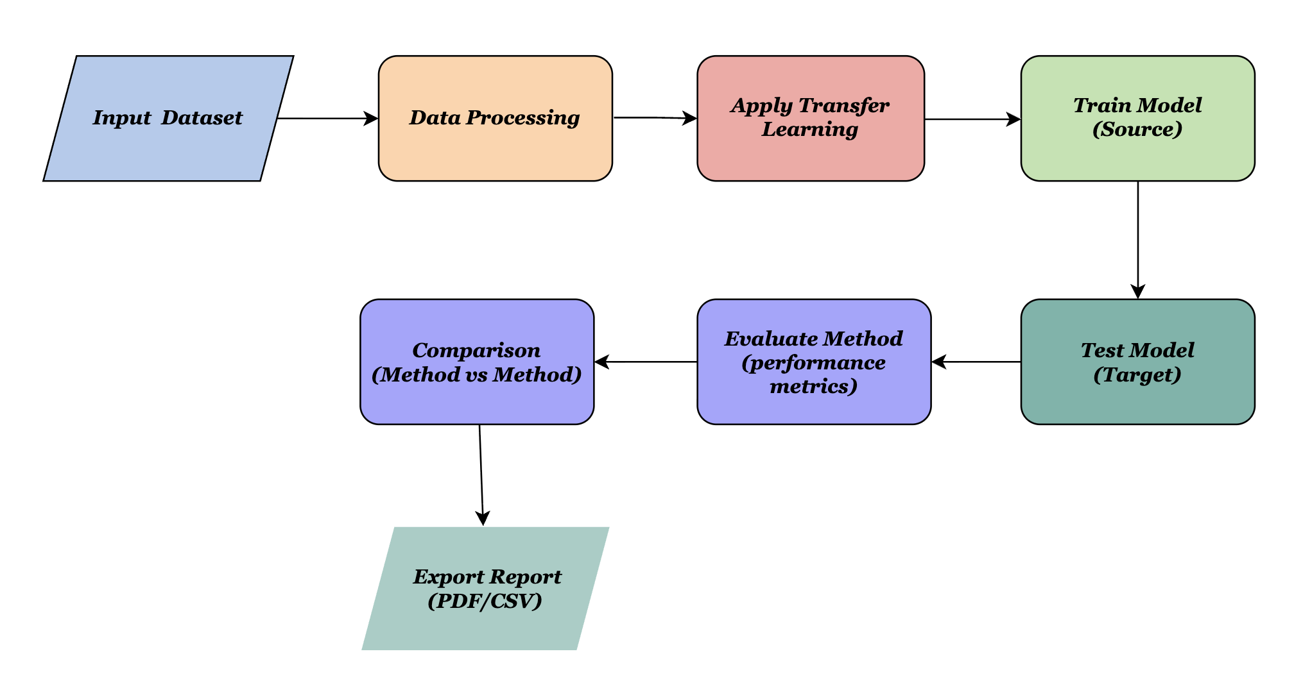
System Architecture
Consistent, configurable processing workflow

Slide 5
Implementation Specifications
Supported languages, datasets, methods, formats, metrics
Programming Languages | Python, PyQt
Datasets | COIL 20, MNIST, PIE, Office-caltech (Surf), Office-caltech (Decaf), Office-31 (Decaf), Reuters, Amazon Review, NASA, AEEEM, RELINK, SOFTLAB
Transfer Learning Methods | TCA, JDA, BDA, CORAL, OCMTL, DALI, JFK, JCSA, OCMTL+ (proposed method by me)
Input file format | .csv, .mat, .arff etc
Output report format | PDF, CSV
Performance evaluation metrics | Accuracy, AUC, F1-Score, Precision, Recall

Slide 6
Conclusion
Summary of contributions
✓
A unified, modular framework for cross-domain transfer learning
✓
Enables fair comparison, visualization, and analysis of 10 transfer learning methods
✓
Helps understand when transfer learning improves or degrades performance (negative transfer detection)
✓
Introduces OCMTL+, an enhanced proposed transfer learning method
✓
Provides a scalable and extensible foundation for new transfer learning algorithms plug in

Slide 7
References
Pan, Sinno Jialin, et al. "Domain adaptation via transfer component analysis." IEEE transactions on neural networks 22.2 (2010): 199-210.
Long, Mingsheng, et al. "Transfer feature learning with joint distribution adaptation." Proceedings of the IEEE international conference on computer vision. 2013.
Wang, Jindong, et al. "Balanced distribution adaptation for transfer learning." 2017 IEEE international conference on data mining (ICDM). IEEE, 2017.
Nahid, Shartaz Sajid, et al. "OCMTL: Transfer learning by orthogonal core-extraction of a matrix and its application in cross-project defect prediction." Alexandria Engineering Journal 133 (2025): 498-516.
Devika, A. K., et al. "Visual domain adaptation through locality information." Engineering Applications of Artificial Intelligence 123 (2023): 106172.
Sun, Baochen, Jiashi Feng, and Kate Saenko. "Correlation alignment for unsupervised domain adaptation." Domain adaptation in computer vision applications. Cham: Springer International Publishing, 2017. 153-171.

Slide 8
Thank You

